Slide 1
Data Augmentation for Object Detection
Zhenju Yin
Supervisor: Franz Koeferl
Machine Learning and Data Analytics for Industry 4.0
Final Presentation
Machine Learning and Data Analytics (MaD) Lab
Friedrich-Alexander-Universität Erlangen-Nürnberg (FAU)
January 29, 2020

Slide 2
Motivation Methods for Augmentation Methods for Detection: YOLO V2 Evaluation and Results Discussion

Slide 3
Motivation Industrial Background Related work : Object detection in general Generic data augmentation Questions

Slide 4
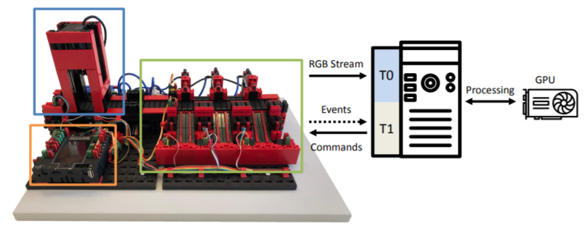
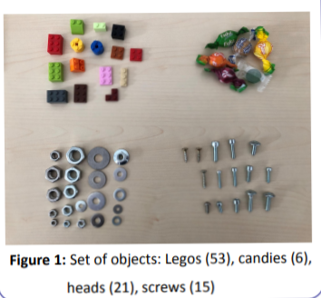
Motivation
A Real-Time RGB-based sorting system
Detect objects on the conveyer
4 classes: candies, heads, screws, and legos.
19.11.2019

Slide 5
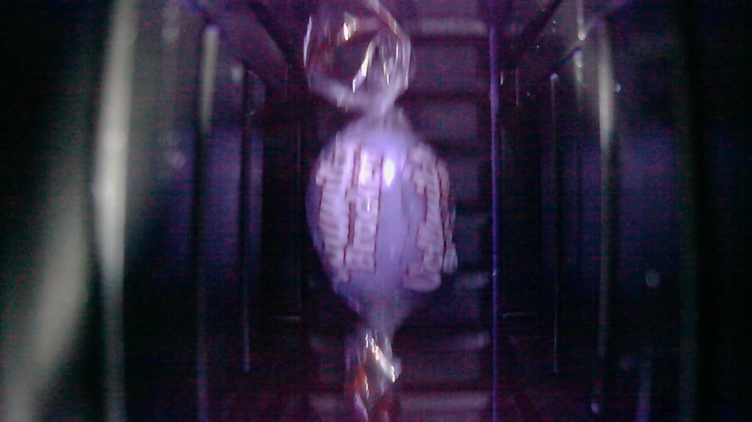
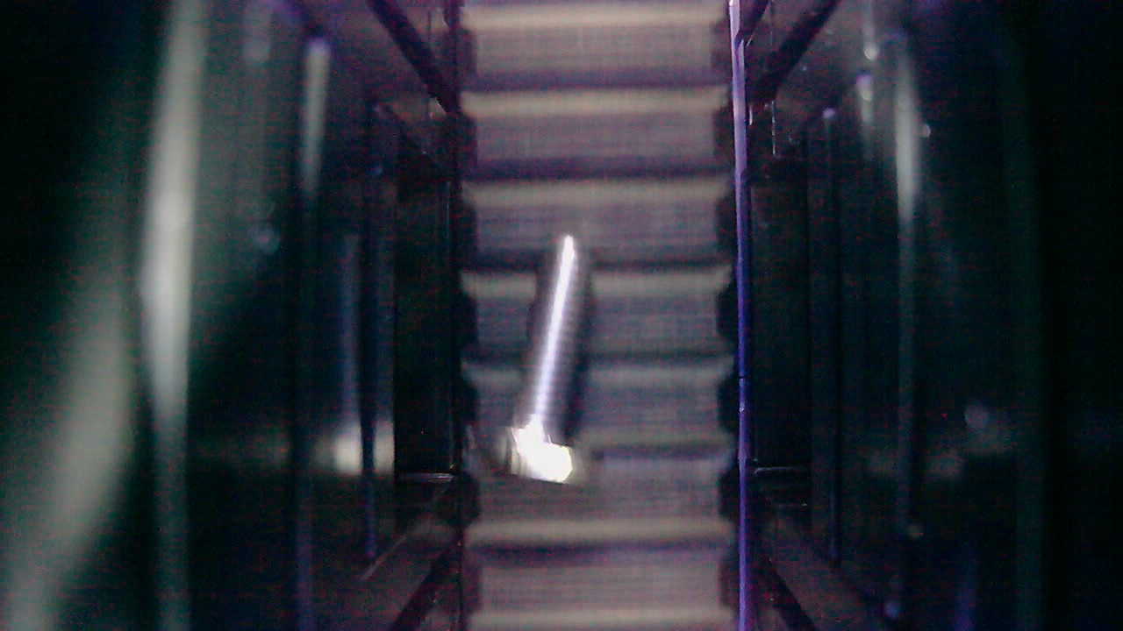
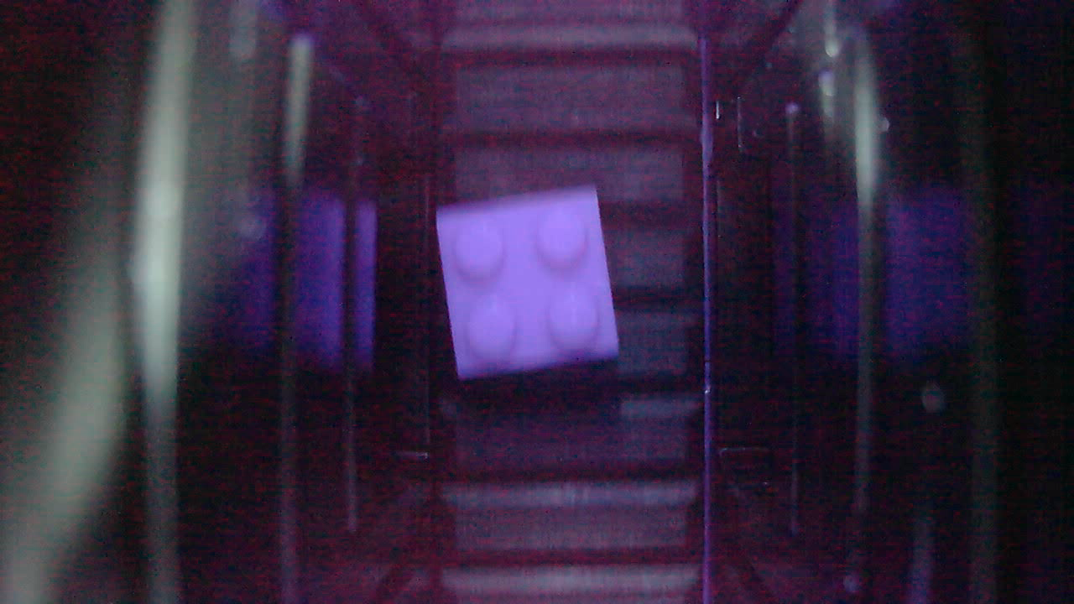
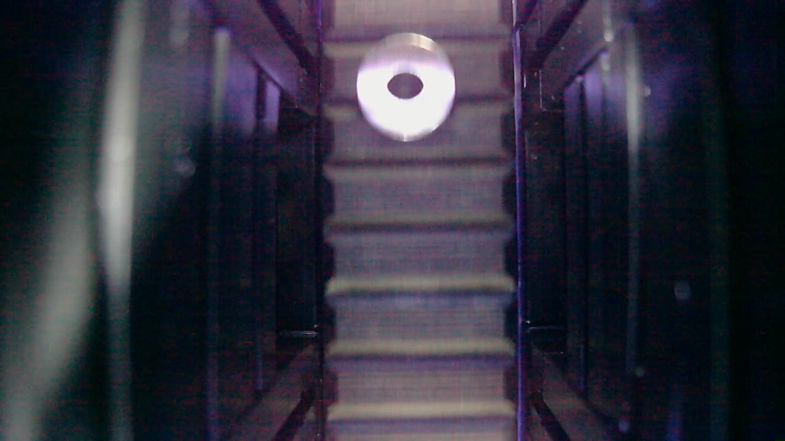
Motivation
Pictures taken from the RGB sorting system
under different levels of ilumination have similar background.
Candy
Screw
Lego
Head
19.11.2019

Slide 6
Motivation Industrial Background Related work : Object detection in general Generic data augmentation Questions

Slide 7
Related Work
Object detection in general
3 main algorithms that are used in the industry.
Faster Region-CNN (R-CNN)
YOLO
Single Shot Detectors (SSDs)
In this case, we choose YOLO to implement object detection and classification.

Slide 8
Related Work
Augmentation in Object Detection
Types of data are usually picture and video, webcam.
There are several methods for augmentation in general.
Addition of Gaussian noise.
Brightness variation.
Addition of Salt and Pepper noise.
Scaling of the image.
Affine rotation given the maximum possible rotation.
Perspective Transform within user provided min and max rotation angle about x, y and z axes.
Image sharpening.

Slide 9
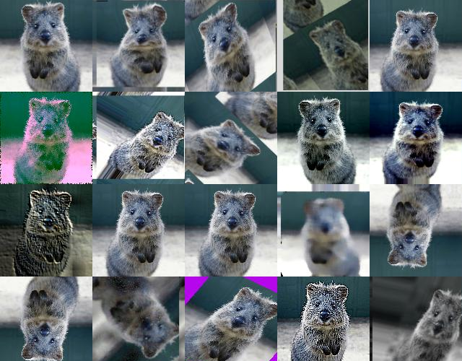
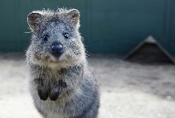
Related Work
Augmentation in Object Detection
Input

Slide 10
Motivation Industrial Background Related work : Generic data augmentation Object detection in general Questions

Slide 11
Research Question
As referred in many papers, if we expand the training dataset, it could improve the performance of the model and increase the rate of correct detections.
However, most methods and proofs are about the transformation of the entire input image instead of only the variance of the objects of interest.
If we keep the invariance of the background and augment foreground/ objects, then can this help or not?
Question:
How does the variance of the objects of interest affect the performance of the model in object detection?

Slide 12
Motivation Methods for Augmentation Methods for Detection: YOLO V2 Evaluation and Results Discussion

Slide 13
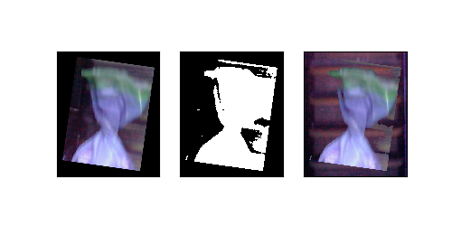
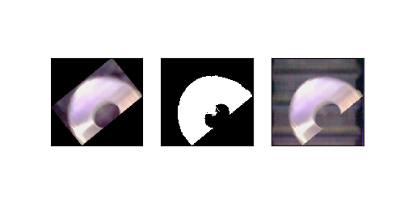
Method
Mask thresholding
1. Extract the information of bounding boxes from the annotations and cut out the area of boxes.
2. Implement random rotations and translations on area of boxes.
3. Remove the background through mask thresholding, e.g. Otsu or triangle, to get the binary images.
4. Randomly choose one empty conveyer image and the appropriate area on the conveyer, splice the new conveyer background and template.

Slide 14

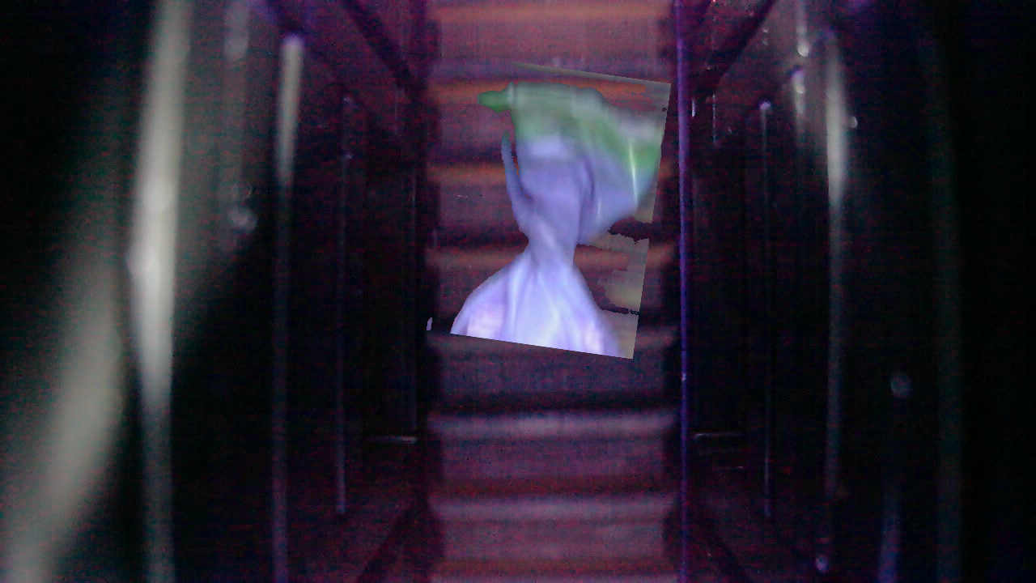
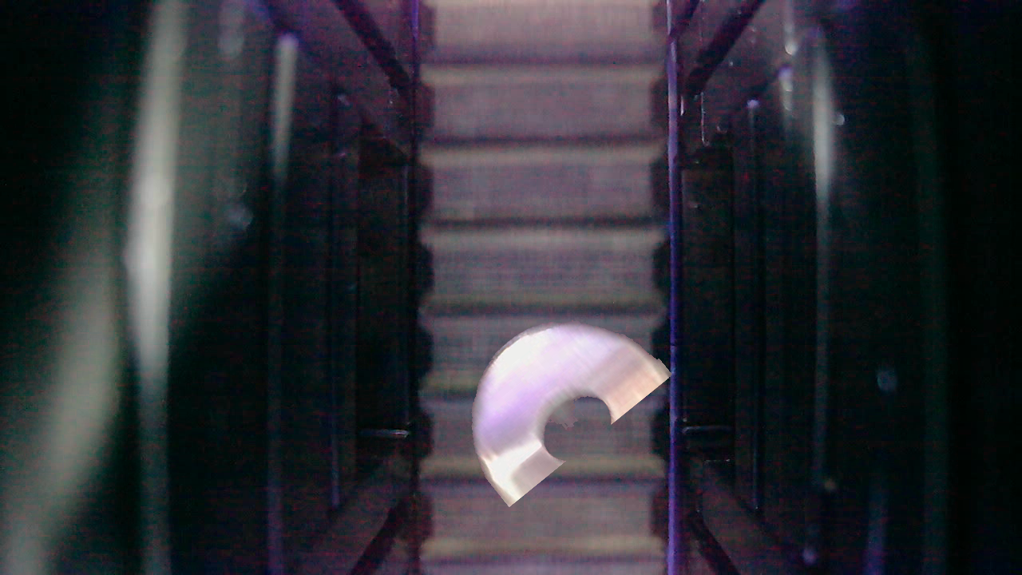
Method
Mask thresholding
5. Paste the new pattern onto the chosen background image and then create one new image

Slide 15
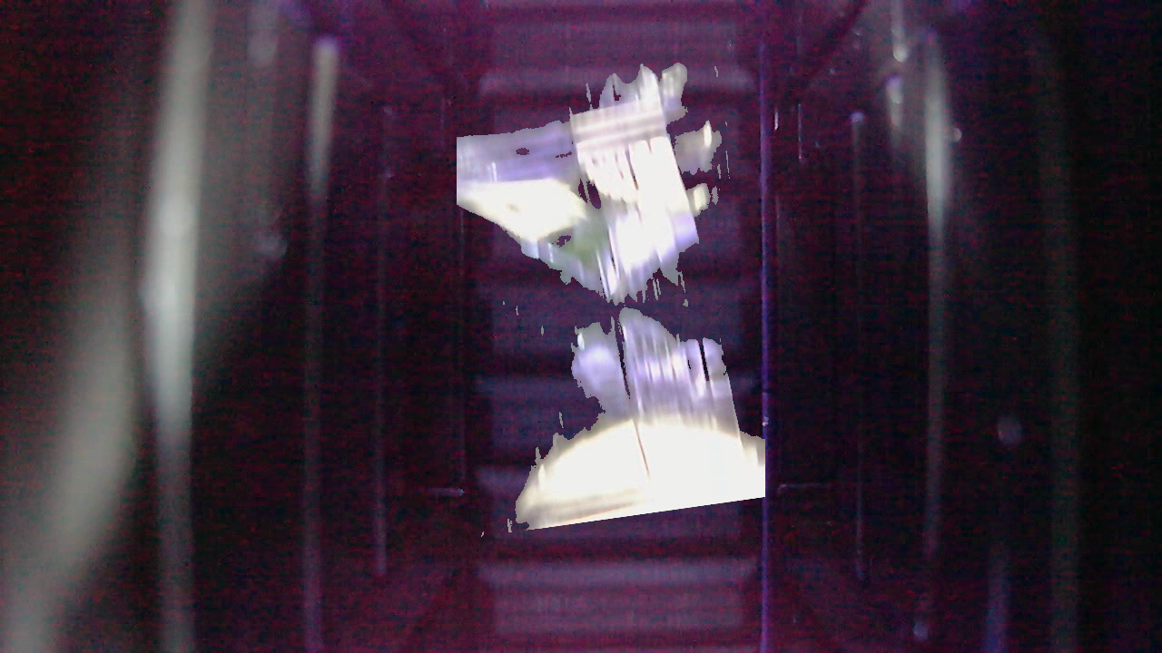
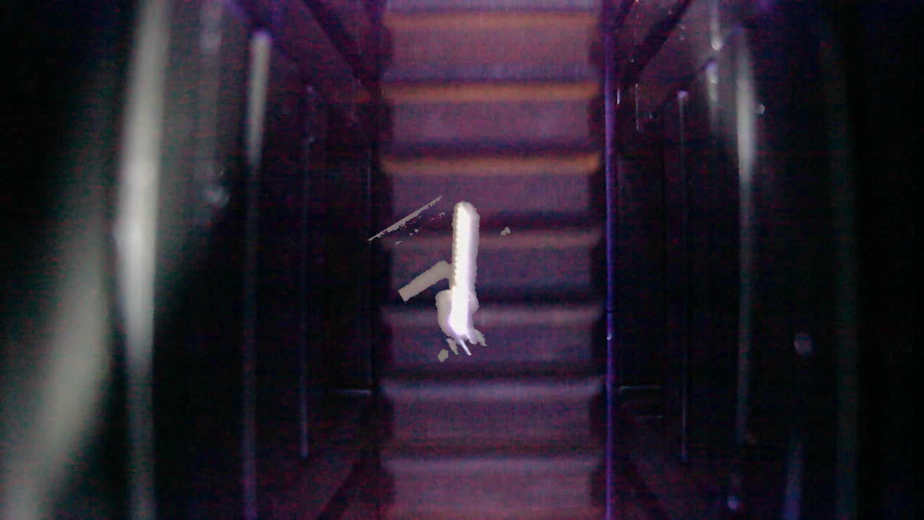
Method
Mask thresholding
5. Paste the new pattern onto the chosen background image and then create new images

Slide 16
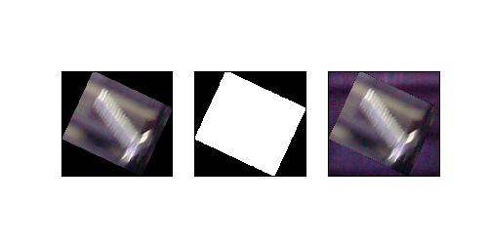
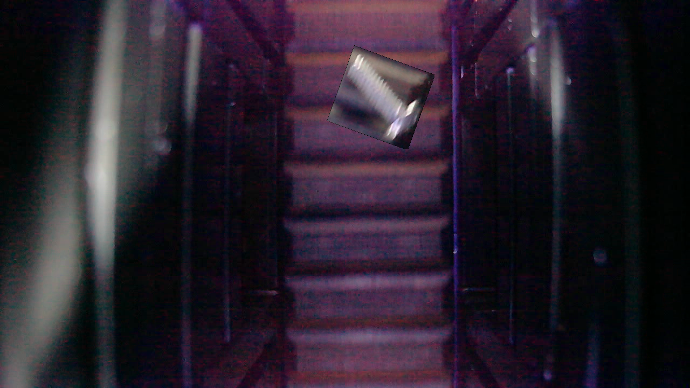
Method
Without removal of background
Get rid of the process of thresholding and completely remain the raw pattern.

Slide 17
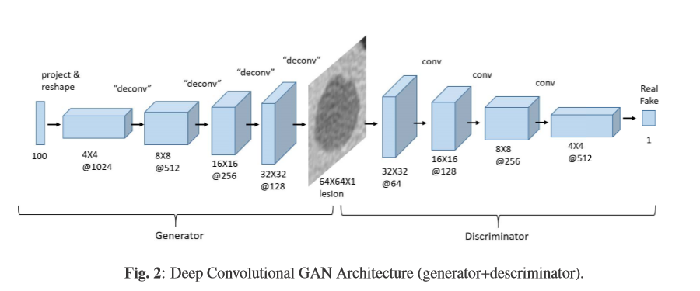
Method
GAN (generative adversarial networks)
Resize original images from 1280x720 to 64x64 as training data.
Learnig rate: 0.0002, AdamOpt , for 150 epochs.

Slide 18
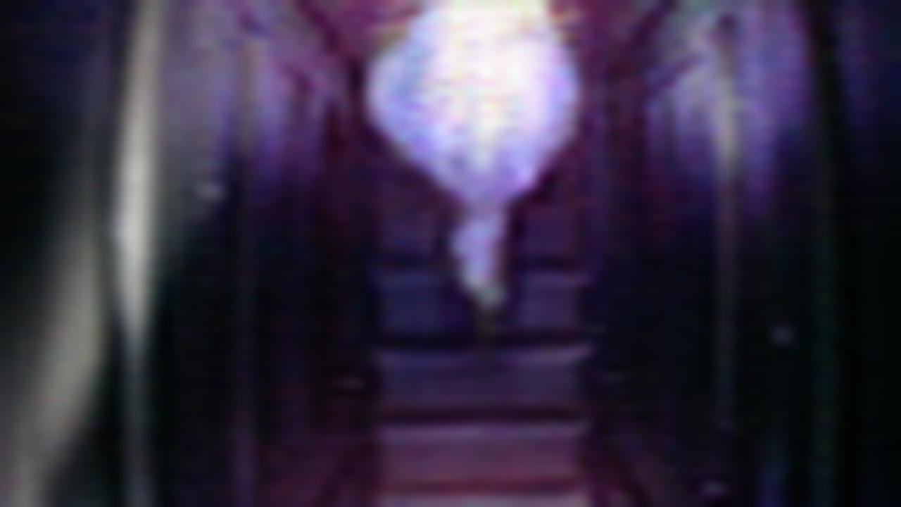
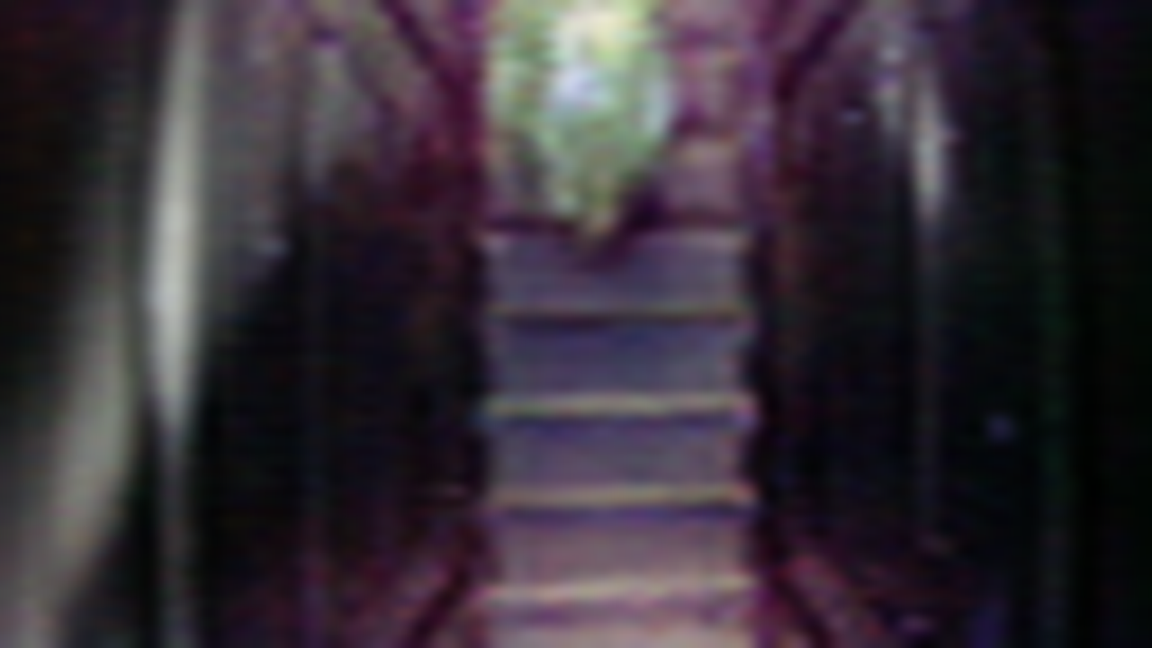
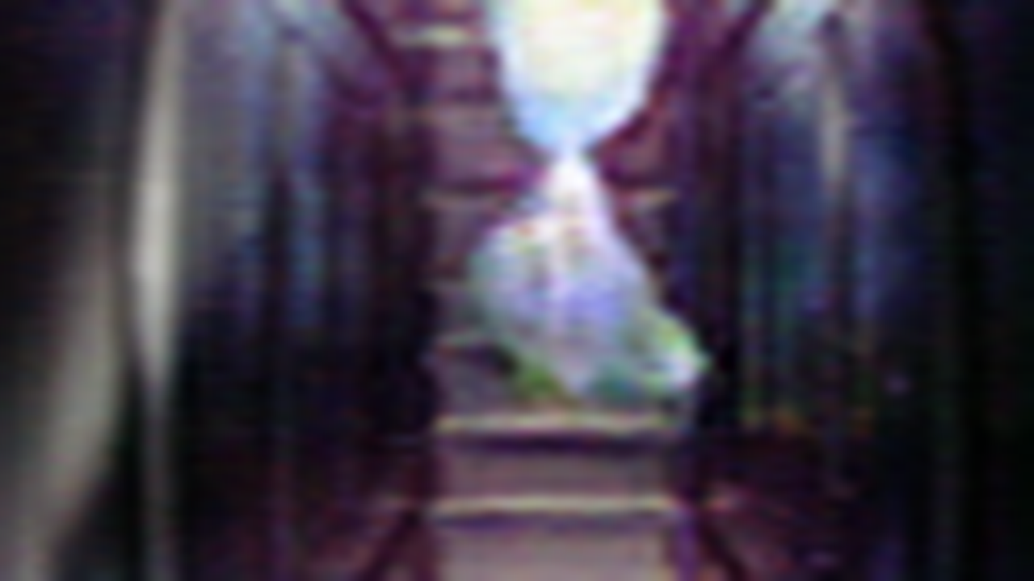
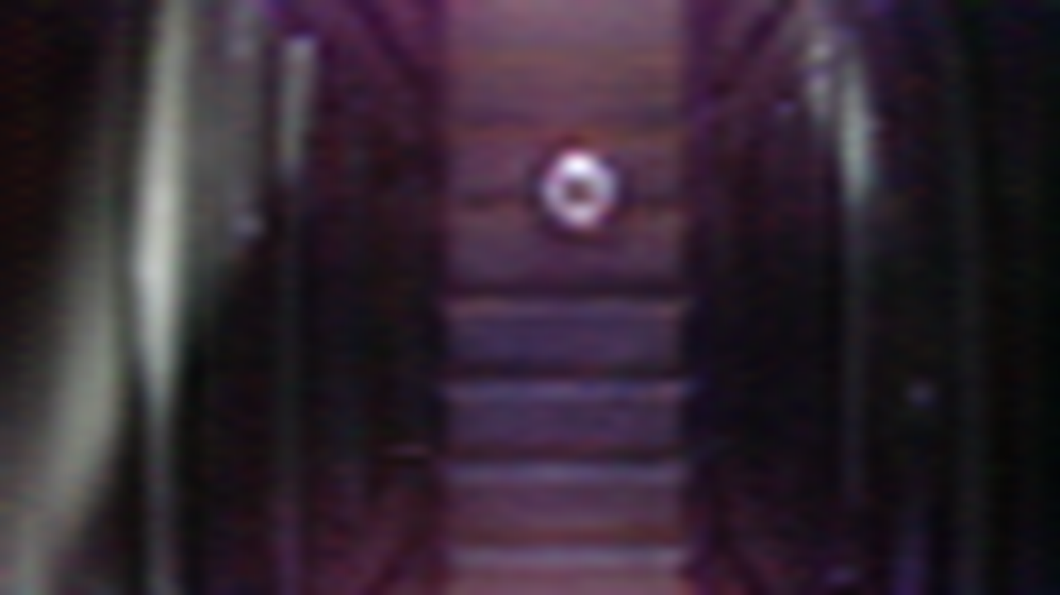
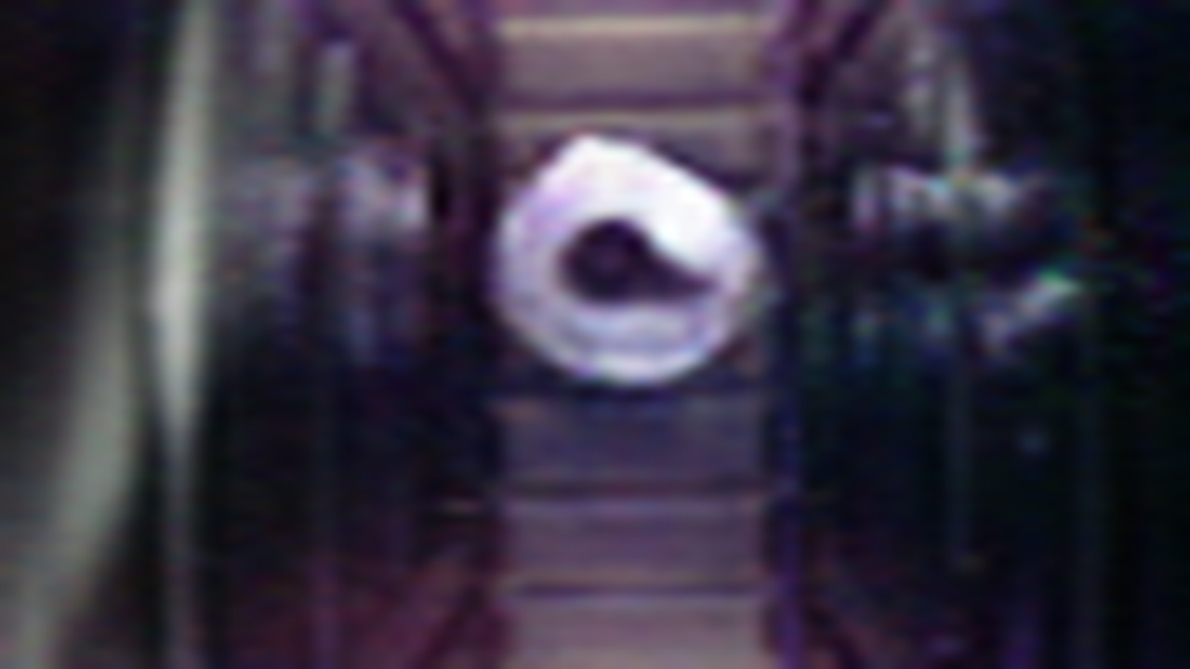
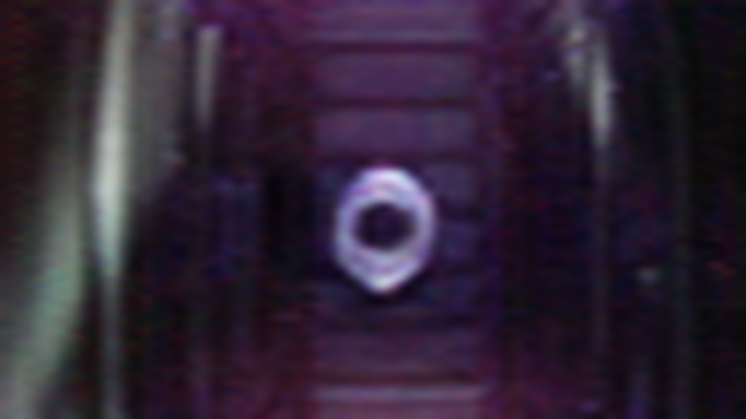
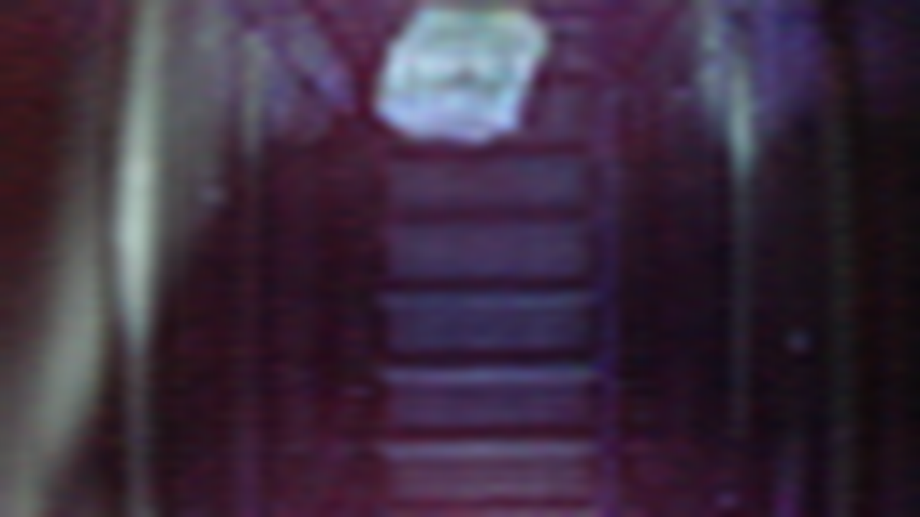
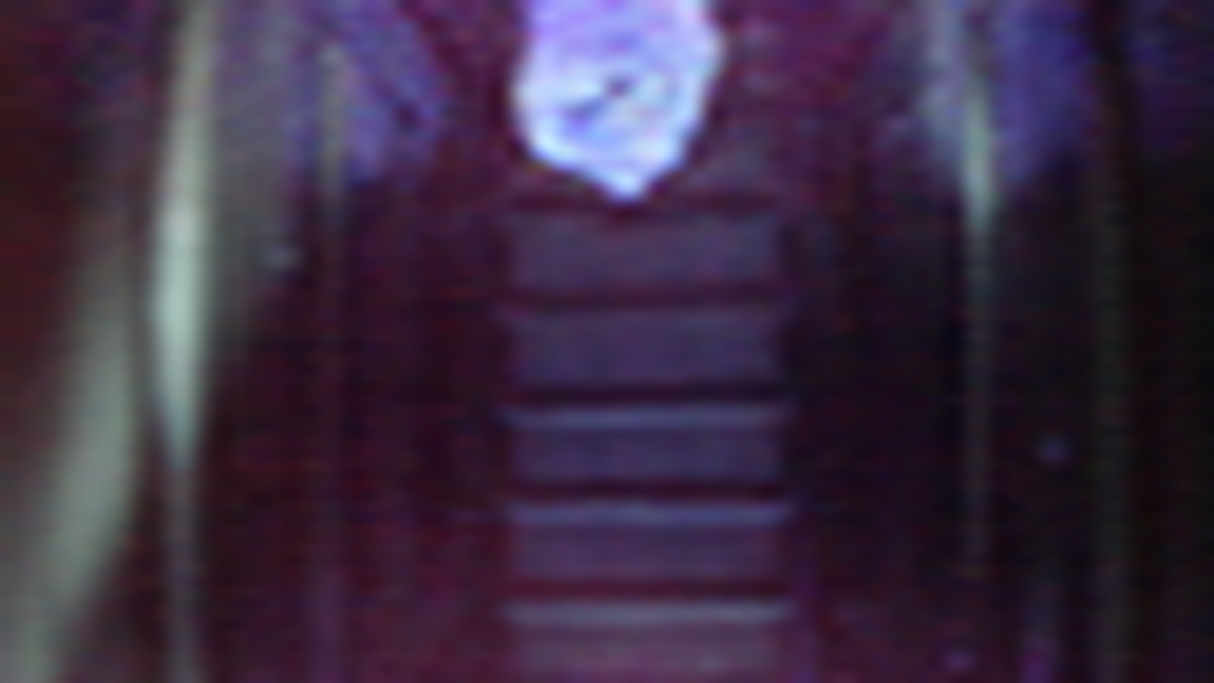
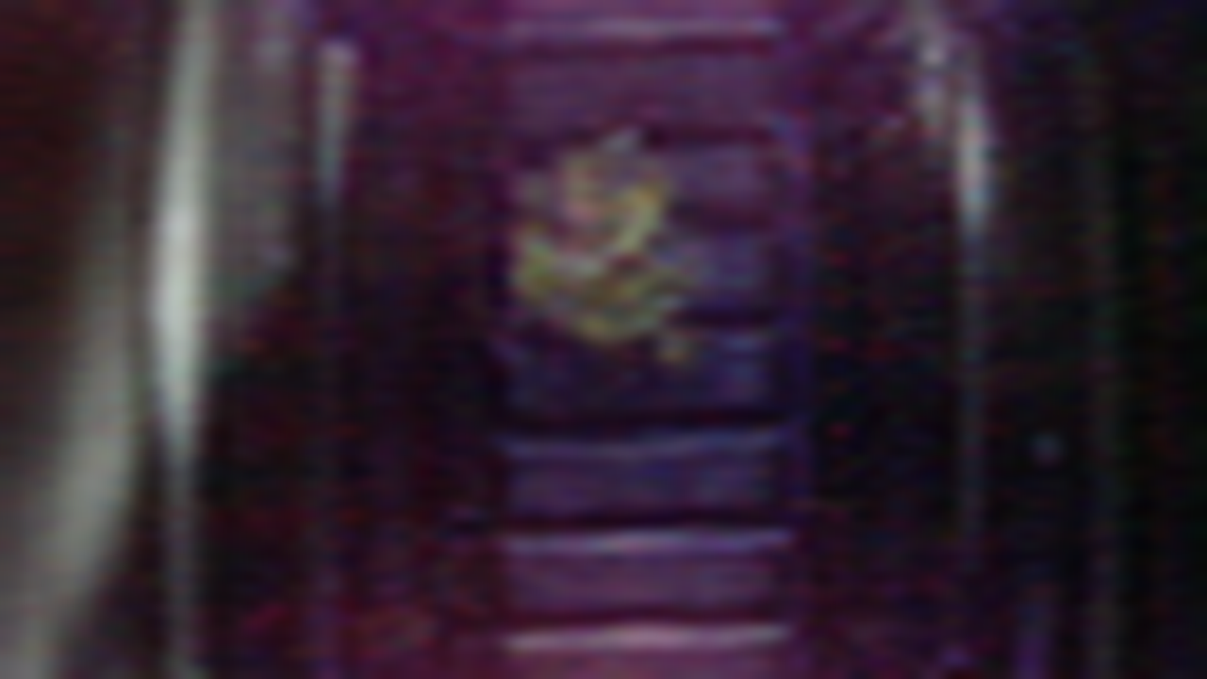
Method
Results of GAN

Slide 19
Motivation Methods for Augmentation Methods for Detection: YOLO V2 Evaluation and Results Discussion

Slide 20
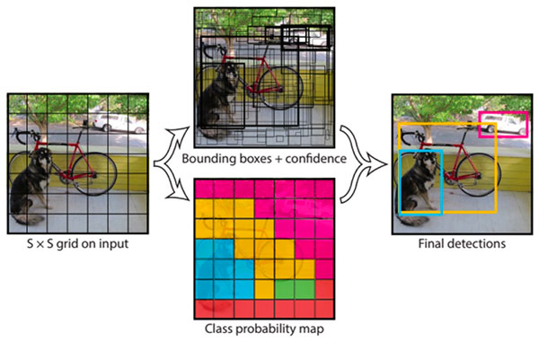
Method for Detection (Yolo)
You Only Look Once
1. Unified Detection
YOLO divides the input
image into an S×S grid.
Each grid cell predicts
only one object.
2. Grid Cell
In this case, for each grid cell,
it predicts 2 boundary boxes and each box has one box confidence score,
it predicts 4 conditional class probabilities (one per class for the likeliness of the object class)
3. YOLO has 24 convolutional layers, followed by 2 fully connected layers (FC).

Slide 21
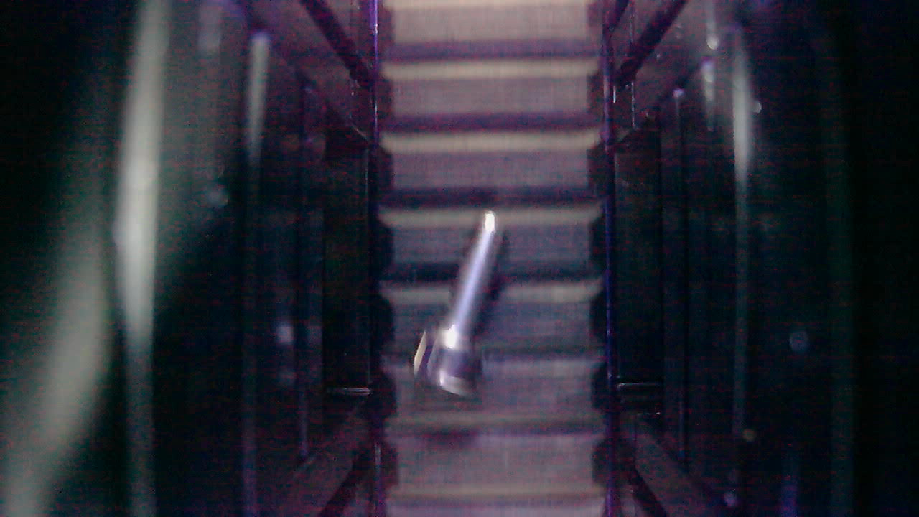
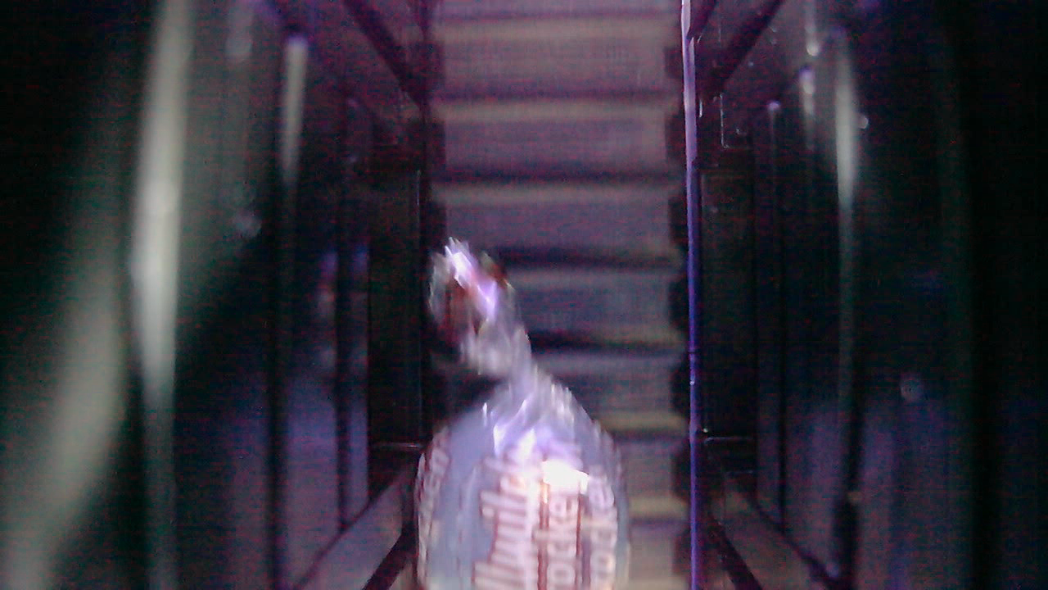
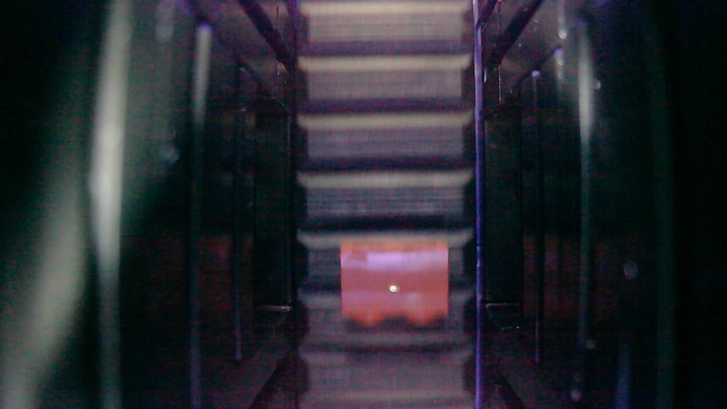
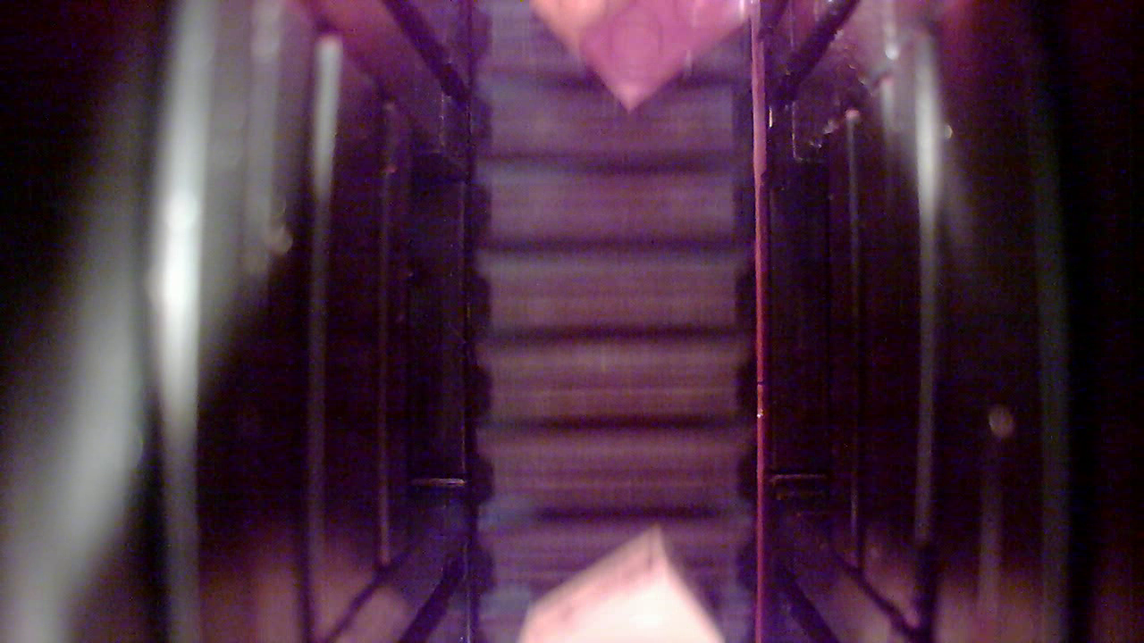
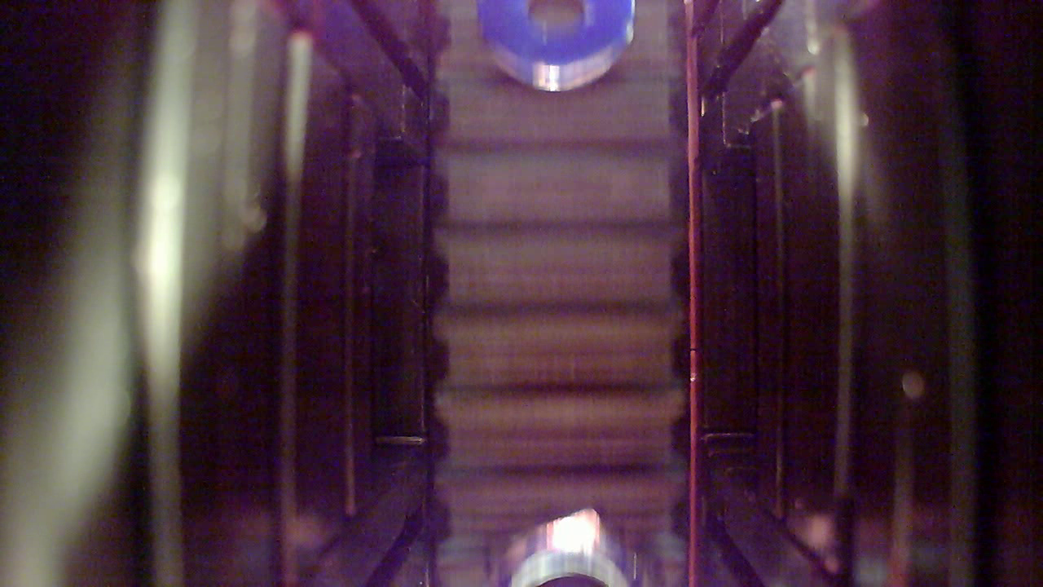
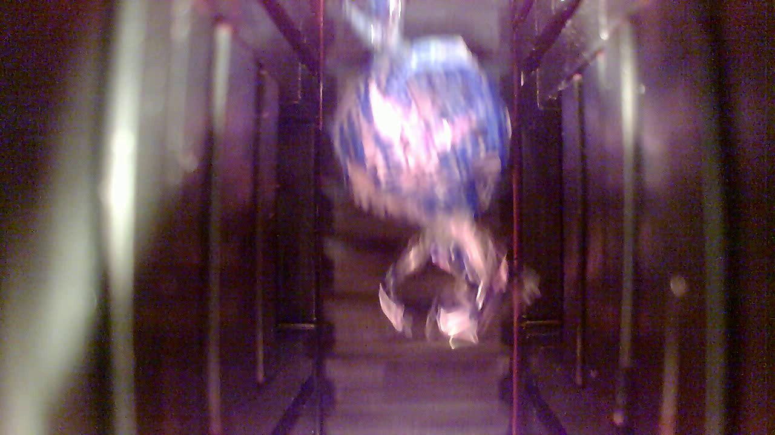
Data for training YOLO model
Original training dataset
Here are examples:
There are totally 22,500 images ( about 5000 per class) of 1280x720.
2,786 empty conveyer images.
Test dataset
Objects and illumination shift, more than one object in an image.
Totally 1,614 images in test dataset.

Slide 22
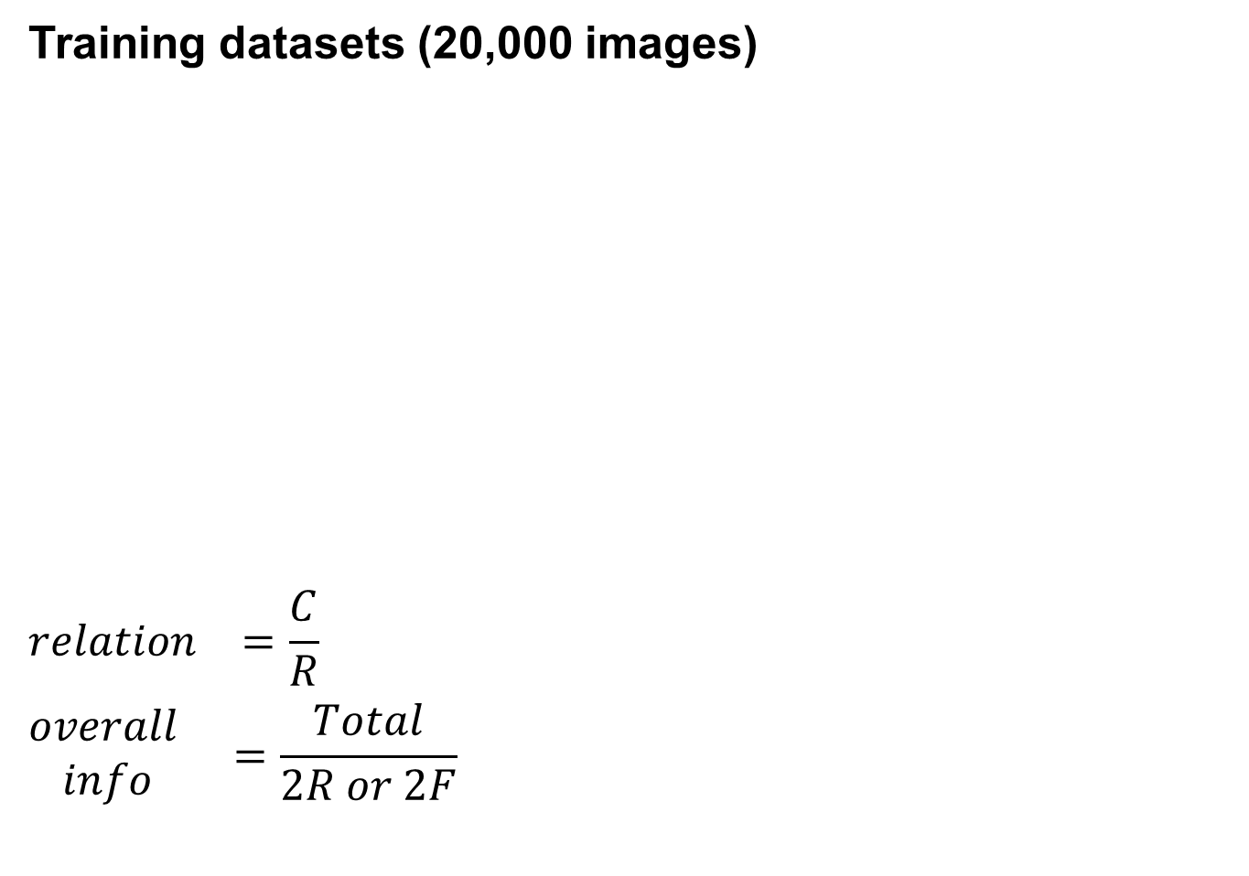
Data for training YOLO model
Training datasets (20,000 images)
$${relation}^{}=\frac{C}{R}$$
$${\begin{aligned}overall \\ info\end{aligned}}^{}=\frac{Total}{2R or 2F}$$
20,000 real images
20,000 fake images
generate
R
F
randomly
randomly
Total
C
10k real images + 10k fake images

Slide 23
Data for training YOLO model
Training datasets (20,000 images)
Hints: Relation represents the similarity between 10,000 real images and 10,000 generated images.
Control variables except for the training dataset.
Batch size: 8, epochs: 15, learning rate: 1e-5.
Group | Raw Images | Synthetic Images | Relation | Overall Information
1 | 20,000 | 0 | / | 100%
2 | 10,000 | 10,000 | 100% | 50%
3 | 10,000 | 10,000 | 87% | 56.5%
4 | 10,000 | 10,000 | 44% | 78%
5 | 10,000 | 10,000 | 0 | 100%
6 | 0 | 20,000 | / | 100%

Slide 24
Motivation Methods for Augmentation Methods for Detection: YOLO V2 Evaluation and Results Discussion

Slide 25
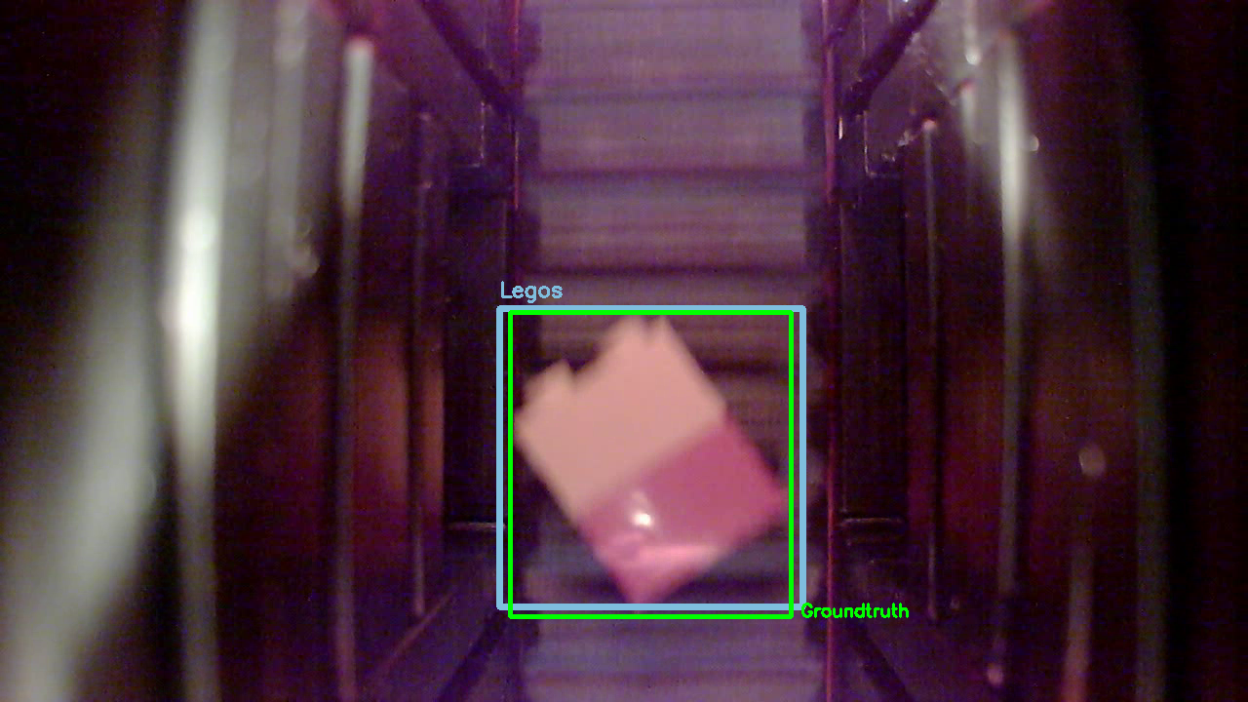
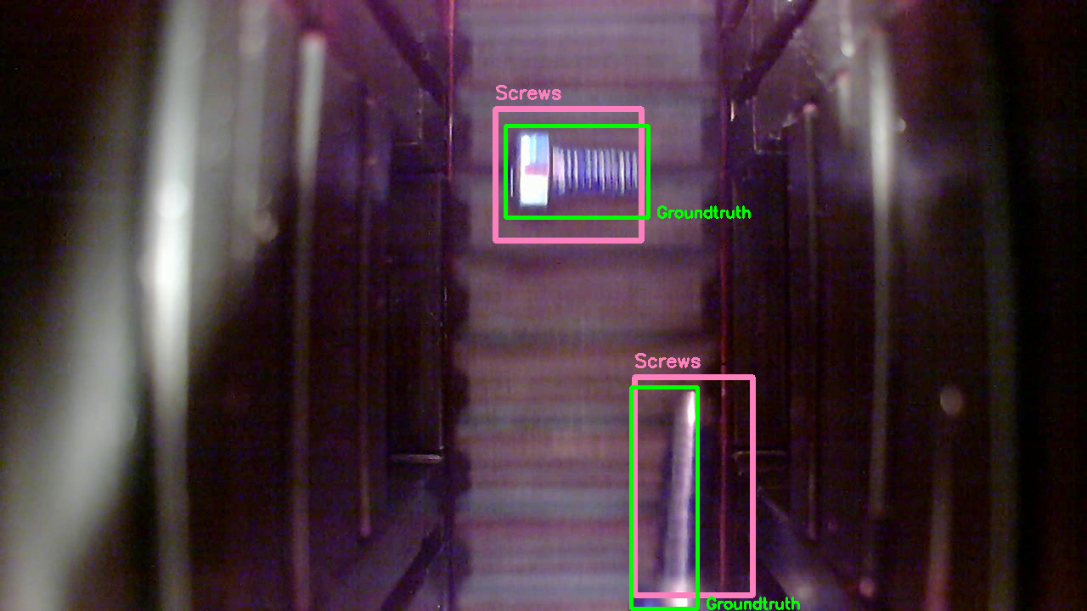
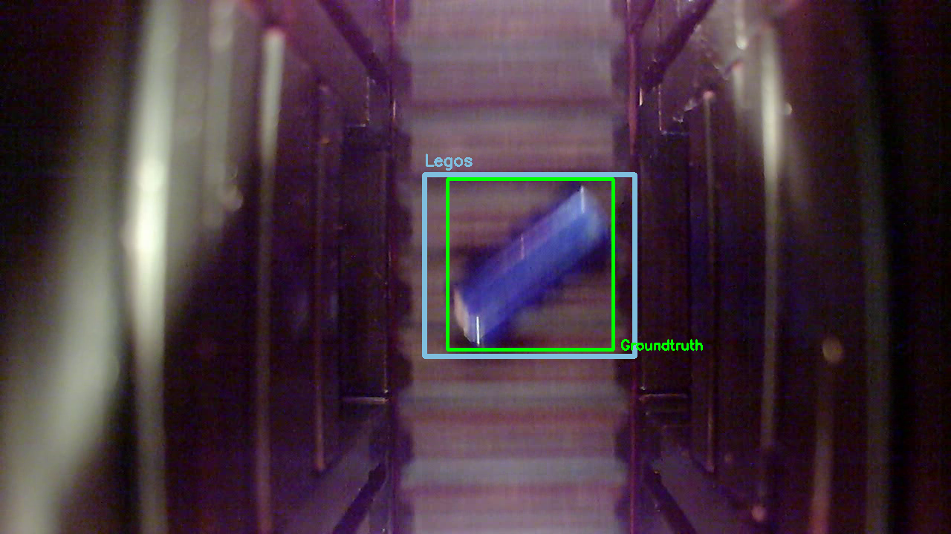
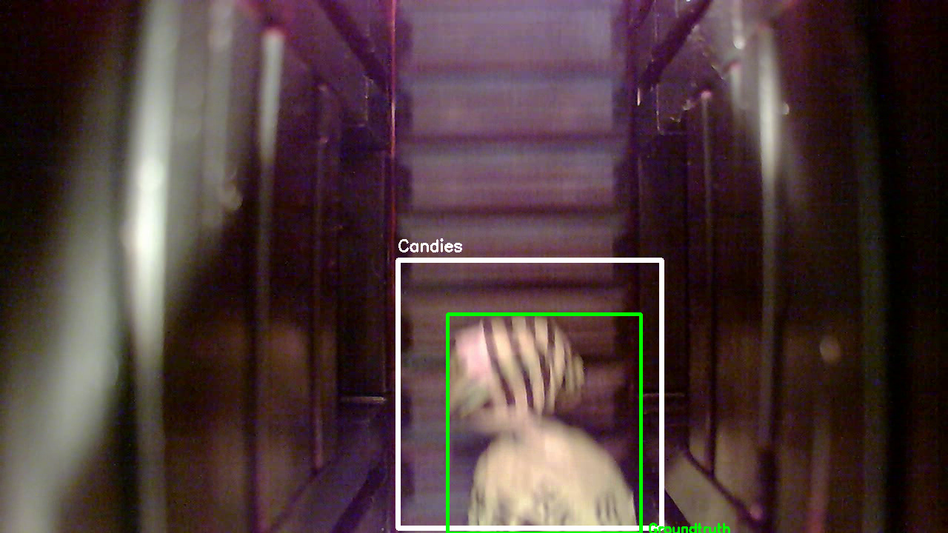
Results
Qualitative (Ground Truth vs. Prediction)

Slide 26
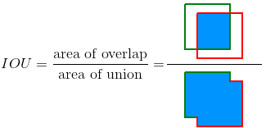
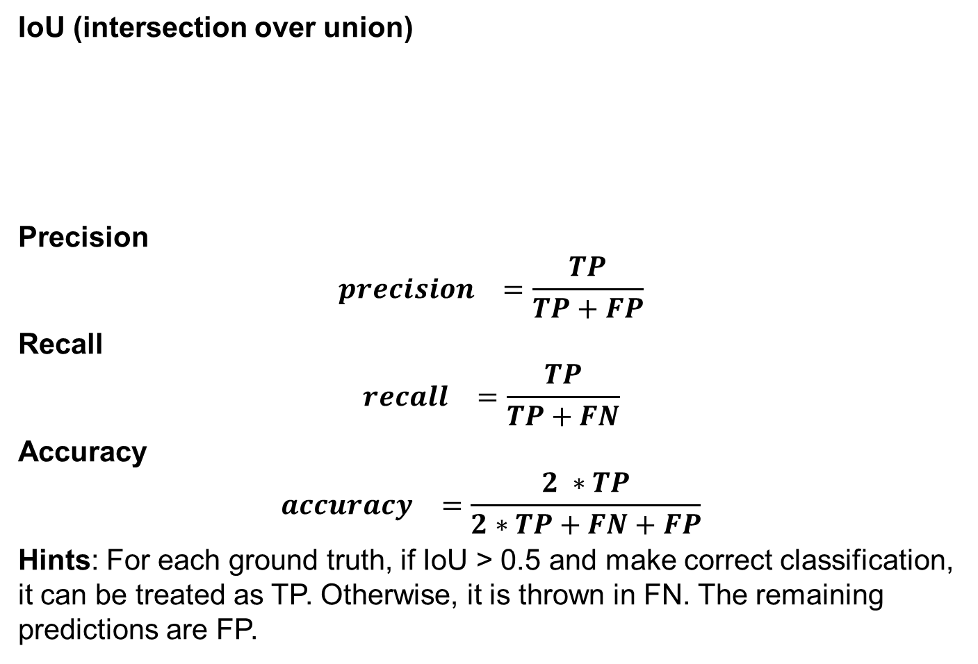
Evaluation-Metrics
IoU (intersection over union)
Precision
$${precision}^{}=\frac{TP}{TP+FP}$$
Recall
$${recall}^{}=\frac{TP}{TP+FN}$$
Accuracy
$${accuracy}^{}=\frac{2 ∗TP}{2∗TP+FN+FP}$$
Hints: For each ground truth, if IoU > 0.5 and make correct classification, it can be treated as TP. Otherwise, it is thrown in FN. The remaining predictions are FP.
 | Actual 1 | Actual 0
Prediction 1 | True Positive | False Positive
Prediction 0 | False Negative | True Negative

Slide 27
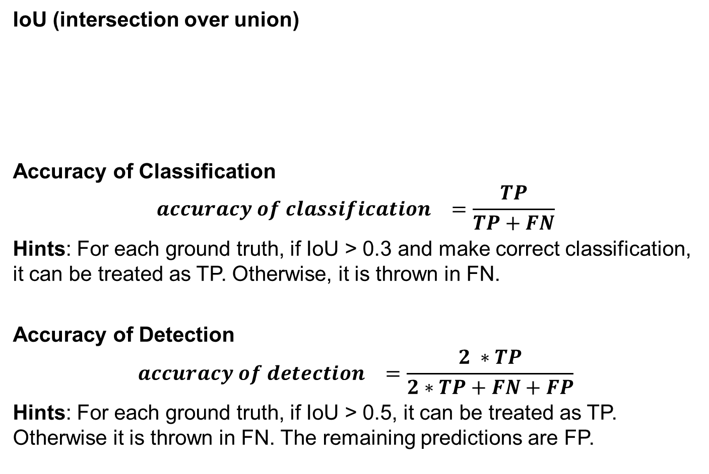
Evaluation-Metrics
IoU (intersection over union)
Accuracy of Classification
$${accuracy of classification}^{}=\frac{TP}{TP+FN}$$
Hints: For each ground truth, if IoU > 0.3 and make correct classification, it can be treated as TP. Otherwise, it is thrown in FN.
Accuracy of Detection
$${accuracy of detection}^{}=\frac{2 ∗TP}{2∗TP+FN+FP}$$
Hints: For each ground truth, if IoU > 0.5, it can be treated as TP. Otherwise it is thrown in FN. The remaining predictions are FP.
 | Actual 1 | Actual 0
Prediction 1 | True Positive | False Positive
Prediction 0 | False Negative | True Negative

Slide 28
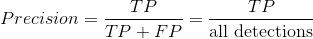
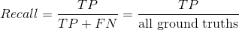
Evaluation-Metrics
Average Precision
We need to draw the Precision/Recall curve(PC curve) first, which is plotted by calculating the precision and recall values of the accumulated TP detections.
For this, we need to order the detections by their confidences, and then plot the precision and recall values we have.

Slide 29
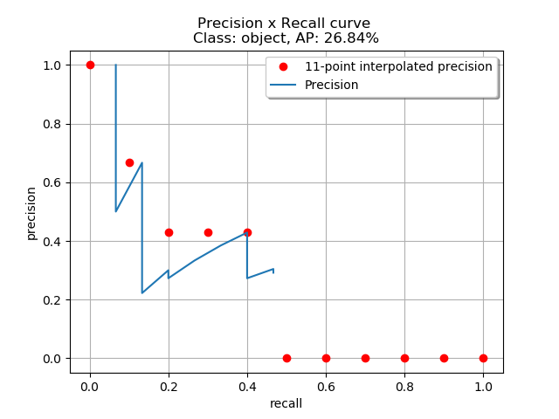
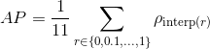
Evaluation-Metrics
There are two different ways to measure the interpolated average precision: 11-point interpolation and interpolating all points.

Slide 30
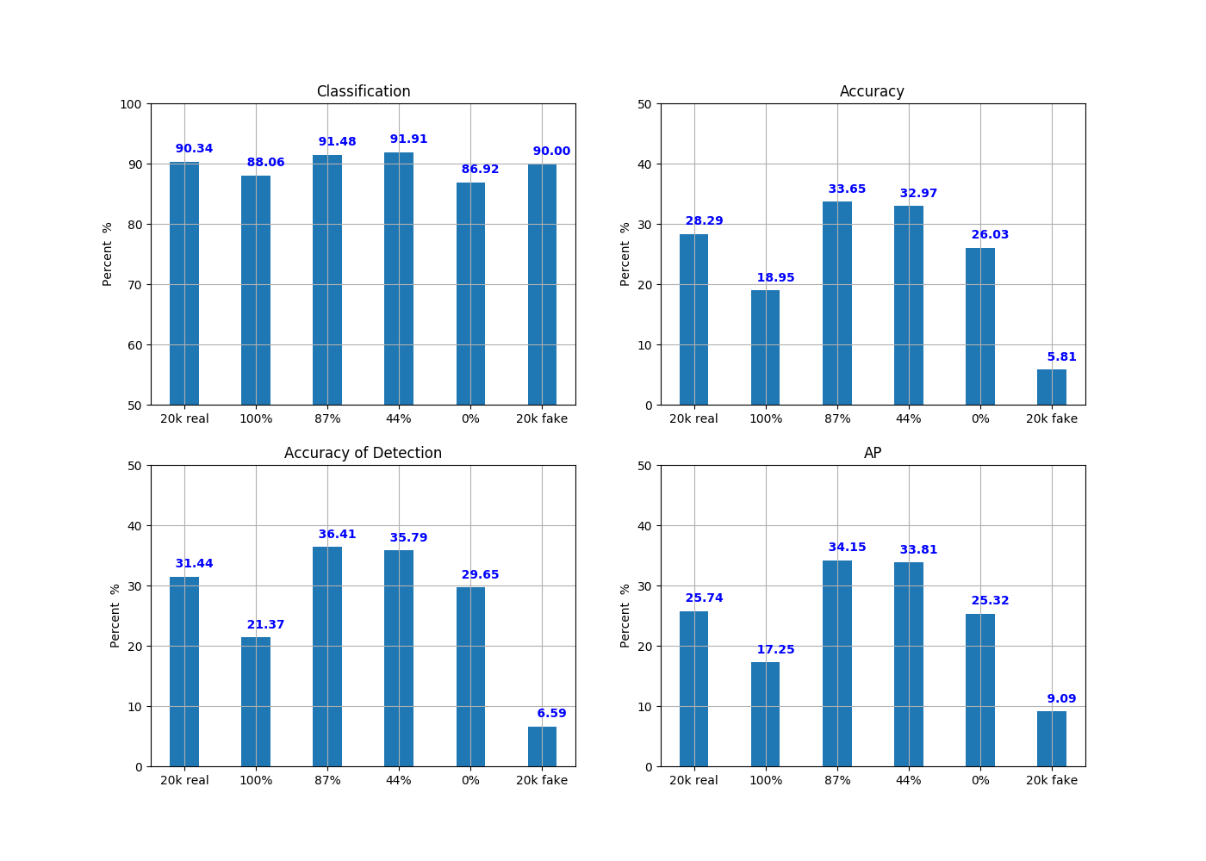
Results
Quantitive

Slide 31
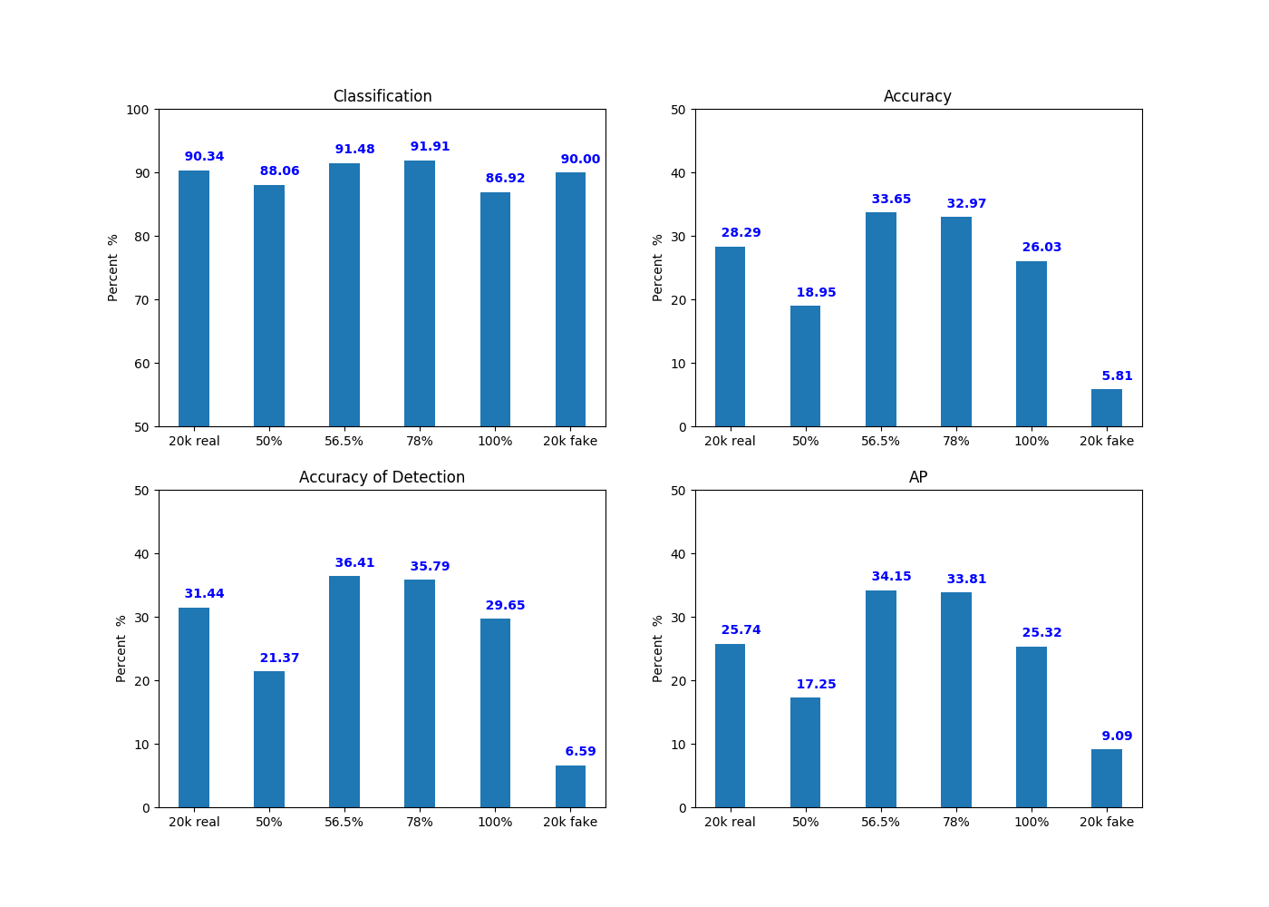
Discussion
Apparently, the variance of objects instead of the whole input can improve the performance of object detection and classification to some extent.
However, this improvement is limited.
When we only rely on the synthetic images, the performance degrades.
If we keep the proportion of
fake images as 50% and alter
the volume of overall information
of training dataset, thus we can
obtain a better or worse trained
model, comparing to the baseline
model.

Slide 32
Discussion
From the graphs below, the volume of overall information has an implicit influence on performance.
When it comes to 100%, then the model has almost the same performance as the 20,000 real images model. However, when it is 50%, the performance becomes worse.
So, the best volume of overall information should range between 50% and 100%.

Slide 33
Discussion
In addition, the effects of this method on object detection and object classification are different. It seems that this augmentation method focuses more on improving the accuracy of detection.
In this case, we can see that generally, YOLO performs well in object classification. While there is still a large space for object detection.

Slide 34
Discussion
Classic Augmentation vs. GAN and thresholding
Pros :
1. Easy to get the accurate information of bounding box in synthetic
images.
That is important for annotation files and an essential part of
training dataset for YOLO detection.
2. No cracked patterns and do not lose any information of original
objects.
Cons:
1. Non-realistic patterns, prone to take the raw background
and the object as a whole.
2. Increase the impact of shift between the training dataset and
test dataset.

Slide 35
Future Work
Considering the shifts between raw training data and test data, we need to add the number and type of experimental training datasets.
For example, we can fix the volume of overall information, and then change the proportion of fake images in the training data and to see how it influences the performance.
We can also try other augmentation methods, such as adding removal of background or adding scaling of objects.
Besides, GAN generates more realistic images, which means it creates more kinds of patterns of objects different from those in the original training dataset. Therefore it is promising to increase the accuracy rate of detection.

Slide 36
Reference
M. Frid-Adar, E. Klang, M. Amitai, J. Goldberger and H. Greenspan, "Synthetic data augmentation using GAN for improved liver lesion classification,"
2018 IEEE 15th International Symposium on Biomedical Imaging (ISBI 2018), Washington, DC, 2018, pp. 289-293.
http://ieeexplore.ieee.org/stamp/stamp.jsp?tp=&arnumber=8363576&isnumber=8363198
J. Redmon, A. Farhadi, “YOLO9000: Better, Faster, Stronger“.
https://arxiv.org/abs/1612.08242
Metrics for object detection: Average Precision
https://github.com/rafaelpadilla/Object-Detection-Metrics#average-precision
Darknet of YOLO
https://github.com/thtrieu/darkflow

